Slide 1
Global Economic and Demographic Trends Analysis

Slide 2
AGENDA
Project Overview
Data Cleaning & Preparation
Data Model & Relationships
DAX Measures Created
Dashboard Walkthrough
Key Insights & Observations
Conclusion

Slide 3
Project Overview
Objective:
To analyze global economic and demographic indicators such as GDP, population, literacy, and infant mortality across countries and regions, and derive meaningful insights using Power BI visualizations and DAX measures.
Dataset Used:
Countries World (demographics)
GDP by Country (1960–2016)
Population per Country
Metadata (region, income group)

Slide 4
Data Cleaning & Preparation
Initial Challenges
Cleaning Steps Performed
Multiple sources and formats:
- SQL
- Excel
- CSV
Inconsistent country names and duplicates
Missing values and unusual outliers
In SQL:
Removed duplicates and handled NULLs using basic cleaning queries. Standardized data types for analysis.
In Excel:
Cleaned headers, removed unwanted columns, and formatted data types.
Performed basic checks before import.
In Power Query (Power BI):
Unpivoted year columns in GDP and Population datasets.
Disabled load for staging tables and filtered outliers.

Slide 5
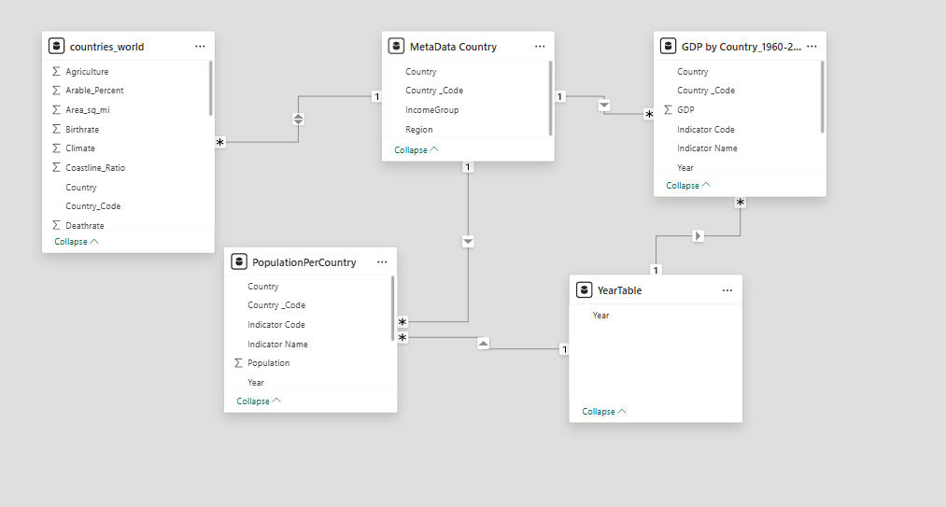
Data Model & Relationships
Model Type:
Star schema design using Metadata as the dimension table
Key Relationships:
Country Code used as the primary key to relate:
GDP by Country
Population per Country
Countries World
All tables connected through Country Code for consistent filtering.
Year column used to enable time-based filtering across visuals.

Slide 6
DAX Measures Created
KPI & Calculated Metrics:
Growth Metrics:
Total_Countries – Distinct count of countries
Total_Population – Sum of population
Avg_GDP_Per_Capita – Average GDP per capita
Avg_Literacy_Rate – Average literacy (excluding outliers)
CY_Population & PY_Population – Population by latest and previous year
Population_Growth_Rate – % change in population
CY_GDP & PY_GDP – GDP by latest and previous year
GDP_Growth_Rate – % GDP growth

Slide 7
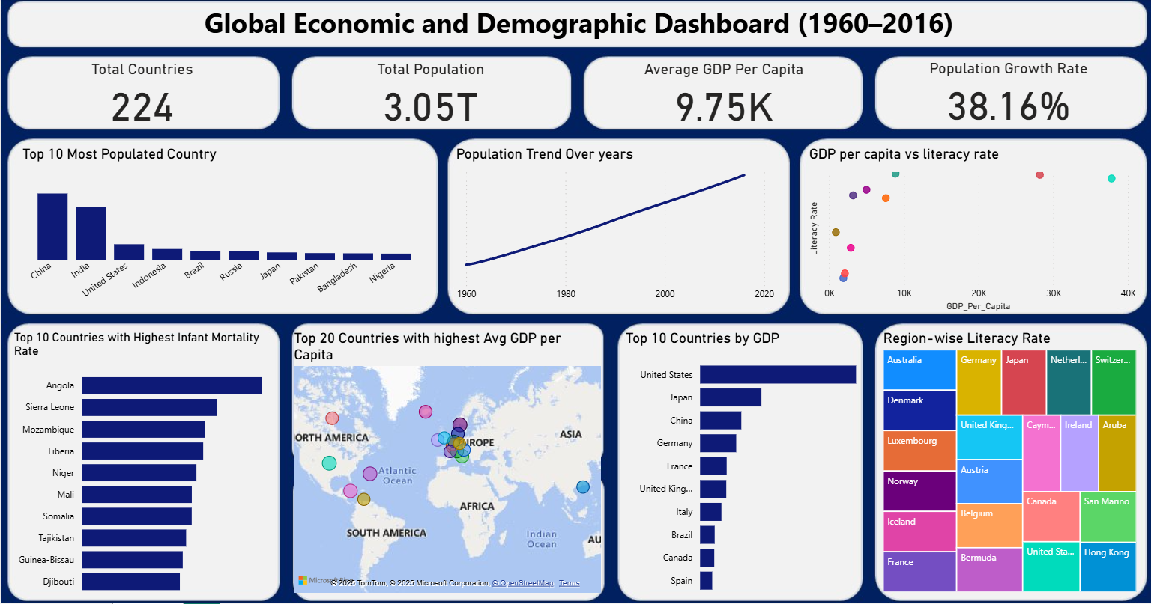
Dashboard Walkthrough

Slide 8
Key Insights & Observations
China & India dominate global population distribution.
Global population increased by 38.16% from 1960 to 2016.
USA, Japan, and China lead in total GDP contribution.
Countries with higher literacy tend to show higher GDP per capita.
High infant mortality remains a challenge in several African nations.
Europe & high-income nations dominate average GDP per capita.

Slide 9
Conclusion
This dashboard paints a clear picture of global development disparities. While population growth has been widespread, wealth and literacy remain concentrated in high-income countries.
A strong link exists between economic prosperity and educational outcomes, as seen in nations with high GDP per capita and literacy. Meanwhile, high infant mortality rates continue to affect low-income regions, highlighting ongoing health challenges.
These insights underline the urgent need for balanced development across education, economy, and healthcare sectors globally.

Slide 10
THANK YOU
Kavitha Balasubramaniam
DA & DS
Batch-08

